Slide 1


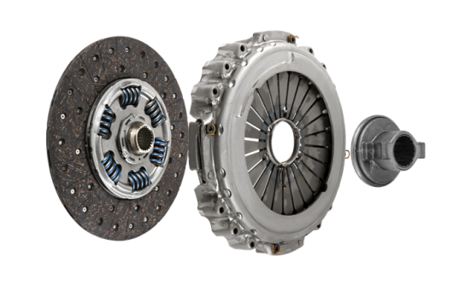
GREEN
TECH
COMMERCIAL VEHICAL
CLUTCHES
More eco-friendly solutions to protect the planet while providing best-in-class quality

Slide 2

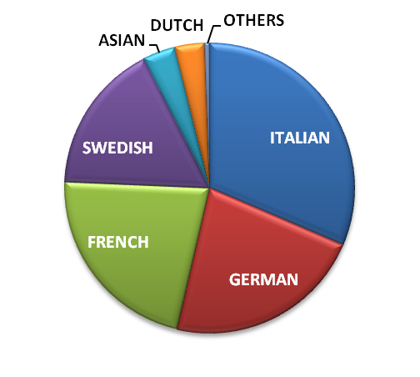
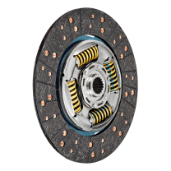
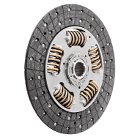
All clutch diameters
including Renault Midlum exclusive clutches (362DBE)
Triple Offer
New
92% coverage (EU)
Remanufactured
90% coverage (EU)
Spare Parts
CV CLUTCHES
200 NEW KIT P/N
+18 by Q1 2019
&
139 REMAN KIT P/N
+20 by Q1 2019
Clutch facings
adapted to each driving style
Share of Valeo sales per CV manufacturer origin
F830TM
for optimized mileage
F510TM
for severe
usage
Notes:
Why is Valeo a legitimate player for the aftermarket solution in this range?
Legitimacy via technology or beacause leader or because OE adquisitions
Market share OE or growth OE
Innovation OE/IAM
Quality references (awards)
Integration in Valeo Group strategy (smart, green solutions...)
Product regognition IAM or OE

Slide 3
CV CLUTCH OFFER
LEGITIMATE POSITIONING
95 years O.E. expertise dedicated
to Commercial Vehicles

Slide 4



RECOGNIZED EXPERT in friction material
Since 1923
CV CLUTCHES
100% equipment on MAN robotized gearboxes
New
O.E. Partner of
on DAF CF-XF since 2017
More than
3 500
CV clutches produced by Valeo every day
Leading O.E. Supplier
of the robotized
Mercedes
Actros MP4
Notes:
Why is Valeo a legitimate player for the aftermarket solution in this range?
Legitimacy via technology or beacause leader or because OE adquisitions
Market share OE or growth OE
Innovation OE/IAM
Quality references (awards)
Integration in Valeo Group strategy (smart, green solutions...)
Product regognition IAM or OE

Slide 5
CV CLUTCH OFFER
WHY CHOOSE VALEO?
A Dual-Offer perfectly adapted to distributor and workshop needs

Slide 6
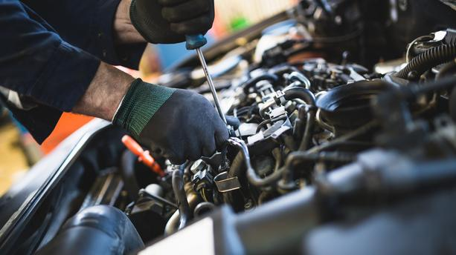
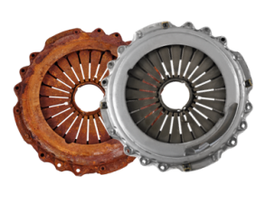

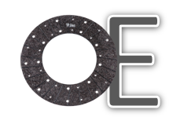

Remanufactured as New
O.E. specifications
Same performance as New
Same warranty
CV CLUTCHES
Probably the best friction material in the world (F510/F830)!
Better comfort
Longer lifespan
No judder
Adapted to each usage
Tech’Care
Experts & Fitting Tips available Online
Notes:
Why is Valeo a legitimate player for the aftermarket solution in this range?
Legitimacy via technology or beacause leader or because OE adquisitions
Market share OE or growth OE
Innovation OE/IAM
Quality references (awards)
Integration in Valeo Group strategy (smart, green solutions...)
Product regognition IAM or OE

Slide 7
CV CLUTCH OFFER
GROWTH OPPORTUNITIES
Develop your business in the most simple way: with Valeo Service

Slide 8



z
THE ESSENTIALS
CHOOSE THE RIGHT CARDS
NEW CARDS
MAKE A DIFFERENCE WITH VALEO
VALEO REF | MAIN APPLICATIONS |  | Kit
805457 | IVECO | IVECO Stralis | Kit3P Mechanical Bearing
827190 | SCANIA | SCANIA G/P/R/T | Kit3P Mechanical Bearing
809125 | IVECO | IVECO Eurocargo | Kit3P Mechanical Bearing
805036 | IVECO | IVECO Eurocargo | Kit3P Mechanical Bearing
827054 | SCANIA | SCANIA G/P/R/T | Kit3P Mechanical Bearing
827258 | MERCEDES | MERCEDES Atego | Kit3P Mechanical Bearing
827064 | IRISBUS | IRISBUS | Kit3P Mechanical Bearing
827173 | IVECO | IVECO Stralis | Kit3P Mechanical Bearing
809126 | IVECO | IVECO Eurocargo | Kit3P Mechanical Bearing
827221 | VOLVO | VOLVO NH / FH / FM | Kit3P Mechanical Bearing
827284 | DAF | DAF HD CF / XF | Kit3P Mechanical Bearing
809148 | RENAULT | RENAULT Premium | Kit3P Mechanical Bearing
827178 | RENAULT | RENAULT Midlum | Kit3P Mechanical Bearing
827025 | MERCEDES | MERCEDES Actros | Kit3P Mechanical Bearing
805295 | MERCEDES | MERCEDES Atego | Kit2P
VALEO REF | MAIN APPLICATIONS |  | Kit
827541 | MAN | MAN TGS-TGX | Kit3P Mechanical Bearing
827547 | DAF | DAF CF/XF | Kit3P Mechanical Bearing
827551 | MAN | MAN TGS-TGX | Kit3P Mechanical Bearing
827555 | MAN | MAN TGS-TGX | Kit2P
827539 | MAN | MAN TGS-TGX | Kit3P Mechanical Bearing
827543 | DAF | DAF XF-CF | Kit3P Mechanical Bearing
827545 | DAF | DAF XF-CF | Kit3P Mechanical Bearing
827553 | MAN | MAN TGS-TGX | Kit2P
827557 | MAN | MAN Lions Coach | Kit3P Mechanical Bearing
827559 | MAN | MAN Lions Regio | Kit3P Mechanical Bearing
827561 | SCANIA | SCANIA L / P / G / R / S | Kit3P Mechanical Bearing
827563 | MAN | MAN Lions Regio | Kit3P Mechanical Bearing
827565 | MAN | MAN Lions Coach | Kit3P Mechanical Bearing
827567 | MAN | MAN TGS-TGX | Twin Disc Clutch
827569 | SCANIA | SCANIA L / P / G / R / S | Kit3P Mechanical Bearing

Slide 9

z
THE ESSENTIALS
CHOOSE THE RIGHT CARDS
NEW CARDS
MAKE A DIFFERENCE WITH VALEO
VALEO REF | MAIN APPLICATIONS |  | Kit
827191 | SCANIA | SCANIA G/P/R/T | Kit3P Mechanical Bearing
827407 | MAN | MAN TGS / TGX | Kit3P Mechanical Bearing
805358 | RENAULT | RENAULT Premium | Kit3P Mechanical Bearing
827026 | MERCEDES | MERCEDES Actros | Kit3P Mechanical Bearing
827259 | MERCEDES | MERCEDES Atego | Kit2P
809136 | MAN | MAN TGA | Kit3P Mechanical Bearing
827294 | SCANIA | SCANIA G/P/R/T | Kit3P Mechanical Bearing
827055 | SCANIA | SCANIA G/P/R/T | Kit3P Mechanical Bearing
827498 | MERCEDES | MERCEDES Actros | Kit3P Mechanical Bearing
827283 | DAF | DAF CF / XF | Kit3P Mechanical Bearing
827165 | RENAULT | RENAULT Premium | Kit3P Mechanical Bearing
809146 | RENAULT | RENAULT Premium | Kit3P Mechanical Bearing
809133 | MAN | MAN TGA | Kit3P Mechanical Bearing
827183 | RENAULT | RENAULT Premium | Kit3P Mechanical Bearing
827179 | RENAULT | RENAULT Midlum | Kit3P Mechanical Bearing
VALEO REF | MAIN APPLICATIONS |  | Kit
827540 | MAN | MAN TGS-TGX | Kit3P Mechanical Bearing
827548 | DAF | DAF CF/XF | Kit3P Mechanical Bearing
827554 | MAN | MAN TGS-TGX | Kit2P
827556 | MAN | MAN TGS-TGX | Kit2P
827558 | MAN | MAN Lions Coach | Kit3P Mechanical Bearing
827572 | MERCEDES | MERCEDES Atego Euro 5 | Kit3P Hydraulic Bearing
827574 | MERCEDES | MERCEDES Atego Euro 5 | Kit3P Hydraulic Bearing
827576 | MERCEDES | MERCEDES Atego Euro 5 | Kit3P Hydraulic Bearing
827578 | MERCEDES | MERCEDES Atego Euro 5 | Kit3P Hydraulic Bearing
827546 | DAF | DAF CF/XF | Kit3P Mechanical Bearing
827552 | MAN | MAN TGS-TGX | Kit3P Mechanical Bearing
827560 | MAN | MAN Lions Regio | Kit3P Mechanical Bearing
827562 | SCANIA | SCANIA F, K, N | Kit3P Mechanical Bearing
827564 | MAN | MAN Lions Regio | Kit3P Mechanical Bearing
827570 | SCANIA | SCANIA F, K, N | Kit3P Mechanical Bearing

